Slide 1
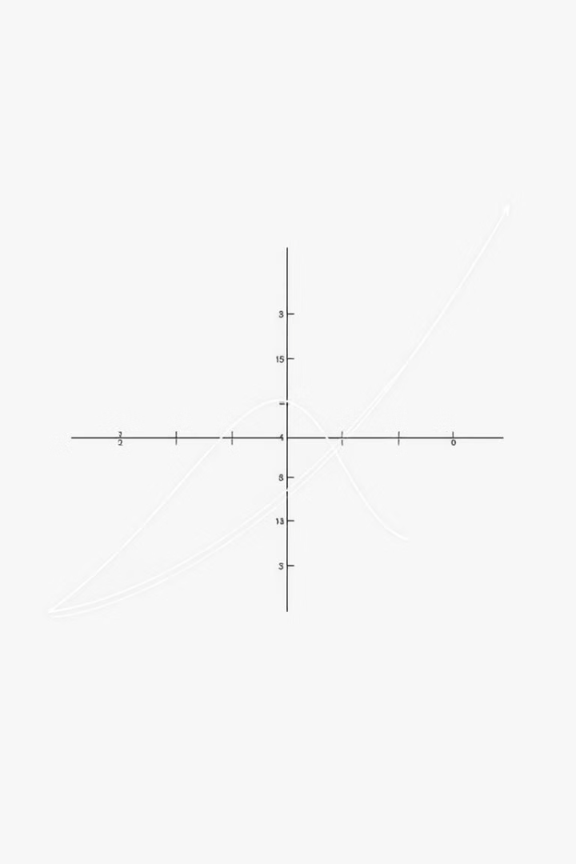
Gamma Function and its Applications in C++
This presentation explores the fascinating world of the gamma function and its numerous applications in C++ programming. Get ready to delve into the mathematical magic behind this powerful tool.

Slide 2
Understanding the Gamma Function
Definition
Properties
The gamma function is a generalization of the factorial function to complex numbers. It's defined as an integral and provides a smooth interpolation for factorials.
The gamma function possesses several key properties, including its relationship to the factorial, its ability to handle non-integer values, and its infinite nature.

Slide 3
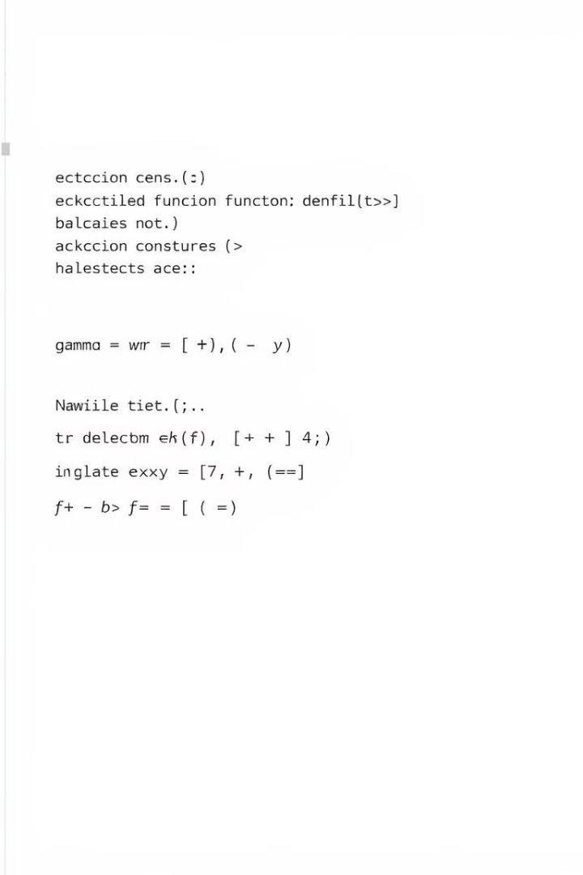
Implementing the Gamma Function in C++
Libraries
Custom Implementation
C++ offers libraries such as the boost library which provides a comprehensive set of mathematical functions, including the gamma function.
It's also possible to create custom implementations of the gamma function using numerical methods like the product series expansion or the Lanczos approximation.

Slide 4


Calculating the Gamma Function using the Product Series Expansion
Product Series Expansion
The gamma function can be calculated using the product series expansion, which involves multiplying an infinite series of terms. This method provides a precise numerical approximation.

Slide 5

Use Cases of the Gamma Function in C++ Programming
1
2
Statistics and Probability
Signal Processing
The gamma function plays a crucial role in various statistical distributions, such as the gamma distribution, the beta distribution, and the chi-squared distribution.
The gamma function is used in signal processing applications, including the design of filters and the analysis of signals.
3
Physics and Engineering
The gamma function has applications in physics, particularly in quantum mechanics and statistical mechanics, as well as in engineering fields like control theory and optimization.

Slide 6
Tips and Best Practices for Working with the Gamma Function
Choose the Right Library
1
Utilize well-established libraries like boost or other specialized libraries that offer optimized implementations of the gamma function.
Handle Special Cases
2
Be mindful of special cases like negative integers and zero, where the gamma function is undefined or takes on special values.
Ensure Accuracy and Efficiency
3
Select numerical methods that provide the desired accuracy and computational efficiency based on the specific requirements of your application.

